Slide 1
San Francisco Bay University
Small Scale E-Commerce
Medinicks - Online Pharmacy store
CS595 - Computer Science Capstone Course
Instructor – Prof. Ahmed Banafa
Sainath Panjala - 20042
Divya Kandimalla - 19899

Slide 2

Overview
Medinicks is a small-scale e-commerce platform for purchasing medicines online. It features a user-friendly interface for searching and ordering medications, with secure authentication.
The platform is built using the MERN stack (MongoDB, Express.js, React, and Node.js), ensuring a fast, responsive, and user-friendly experience.

Slide 3
Purpose of Integration
1. Backend and Frontend Roles:
Backend: Handles data management and user authentication. Built with Node.js, Express.js, and MongoDB, it processes requests and sends data to the front-end.
Frontend: The user interface, built with React.js and CSS, allows users to interact with the app by displaying data from the back-end.
2. Why Integration Matters:
Integration ensures real-time data exchange between front-end and back-end for a smooth user experience.
It enables secure processing of sensitive information like user login and transactions.

Slide 4
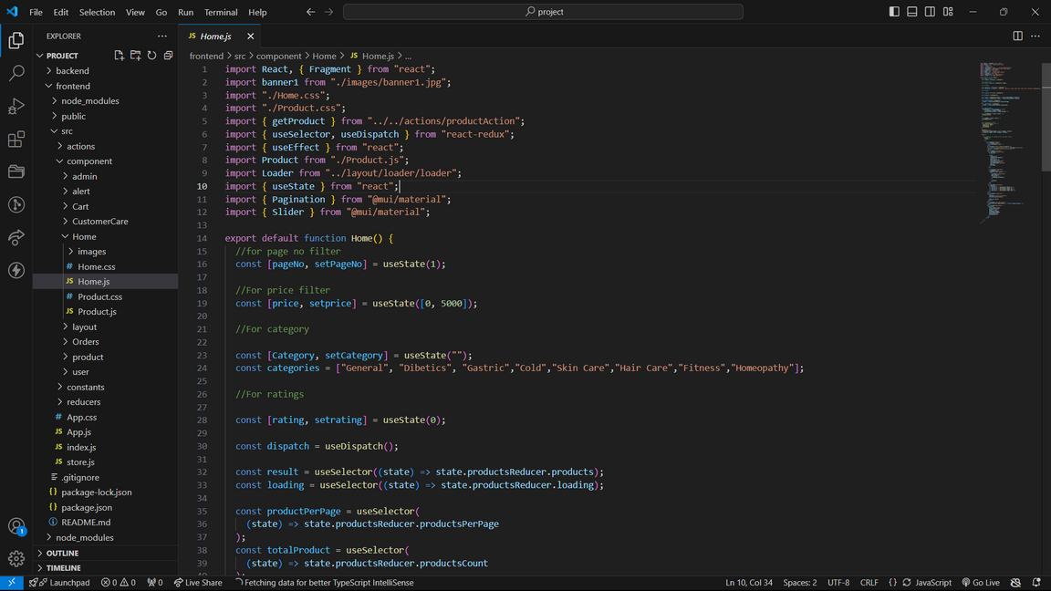
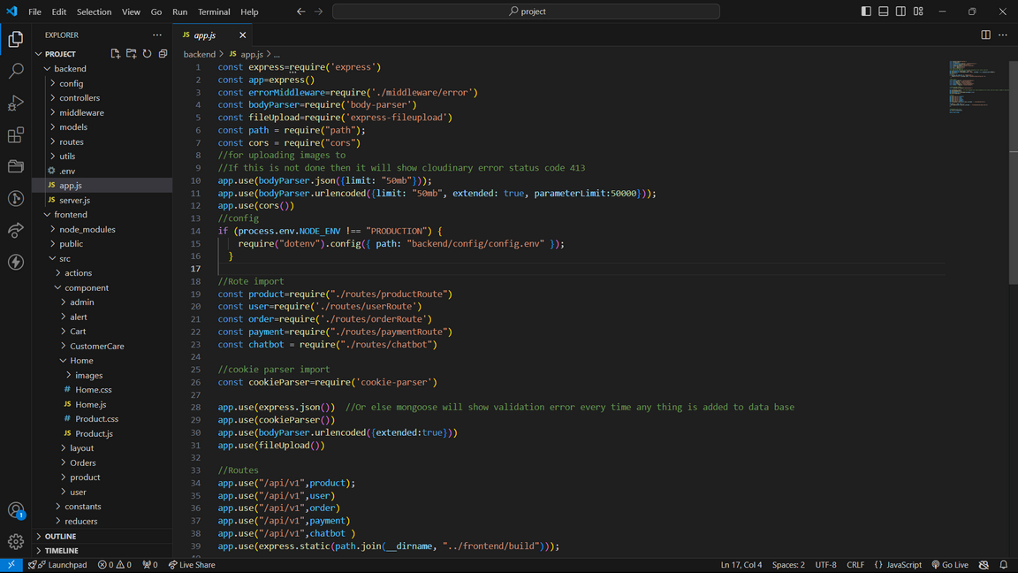
Backend Code
Server.js
App.js

Slide 5

Frontend Code
Home.js

Slide 6
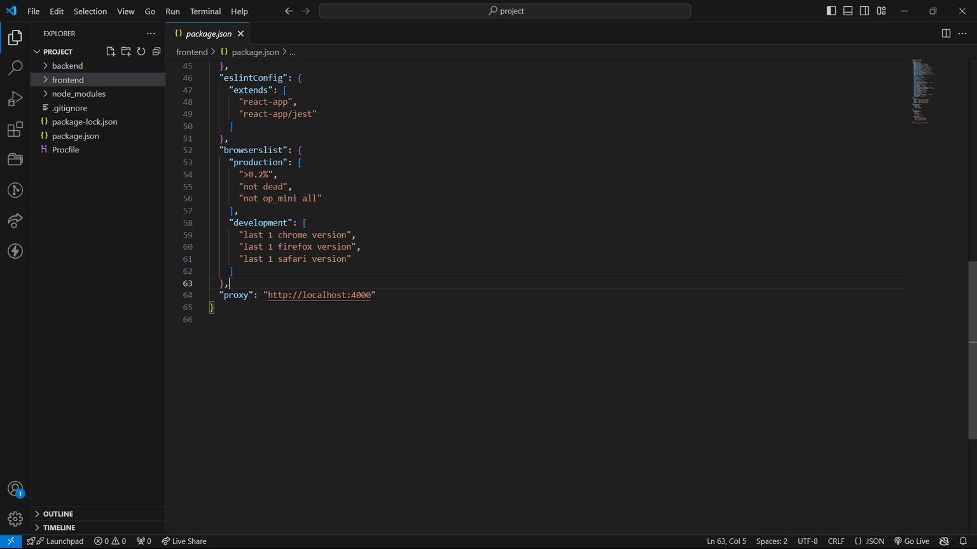
Integration
Link the backend link as proxy in frontend package.json

Slide 7
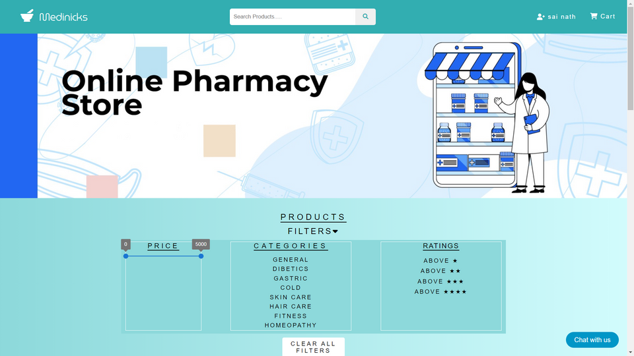
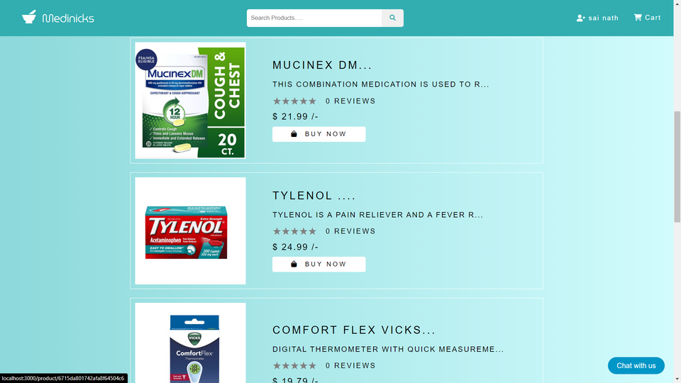
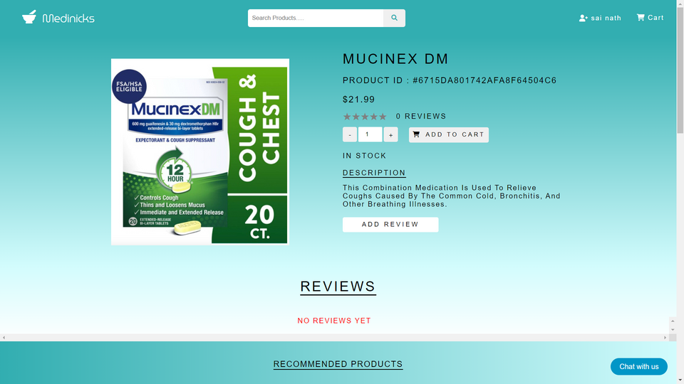
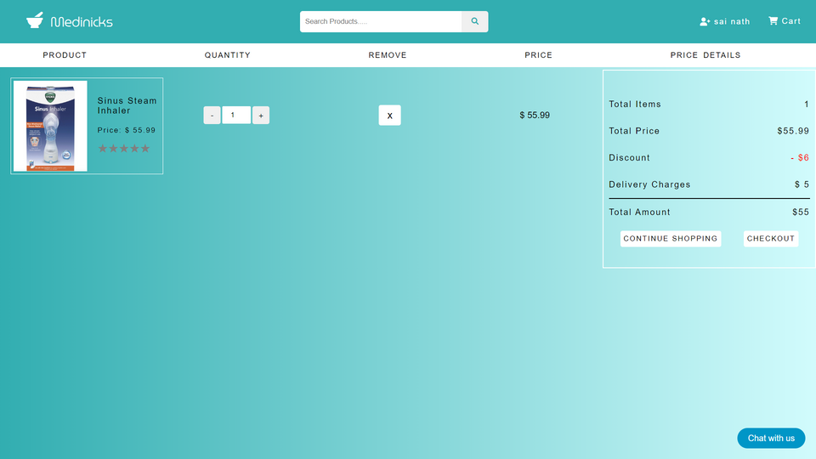
Website Interface
Home page
Products List
Product details
Cart

Slide 8
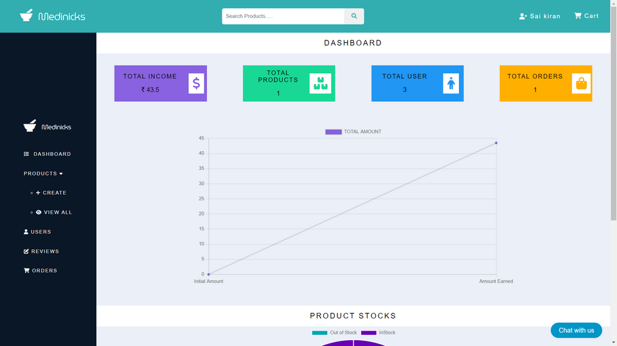
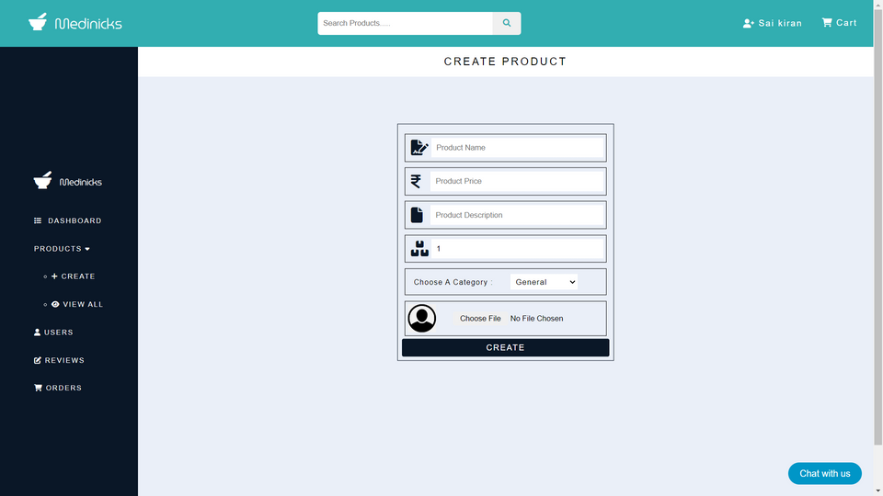
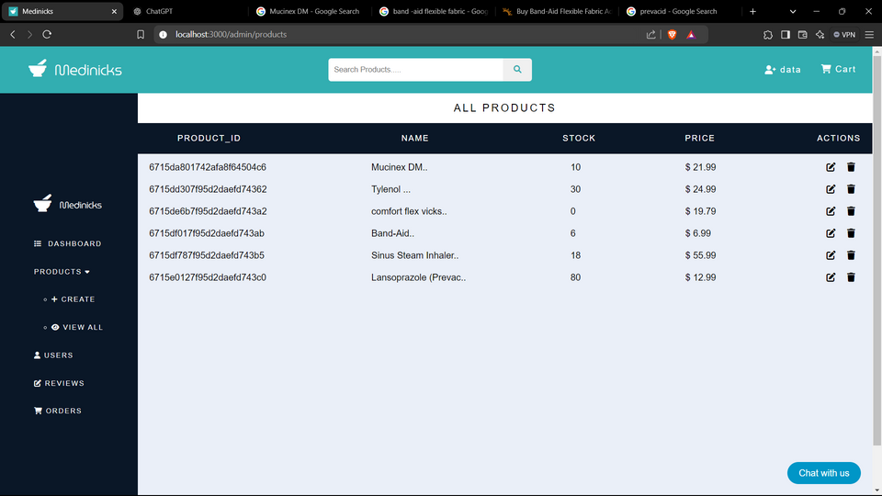
Admin Interface
Admin panel
Add product
Products list

Slide 9

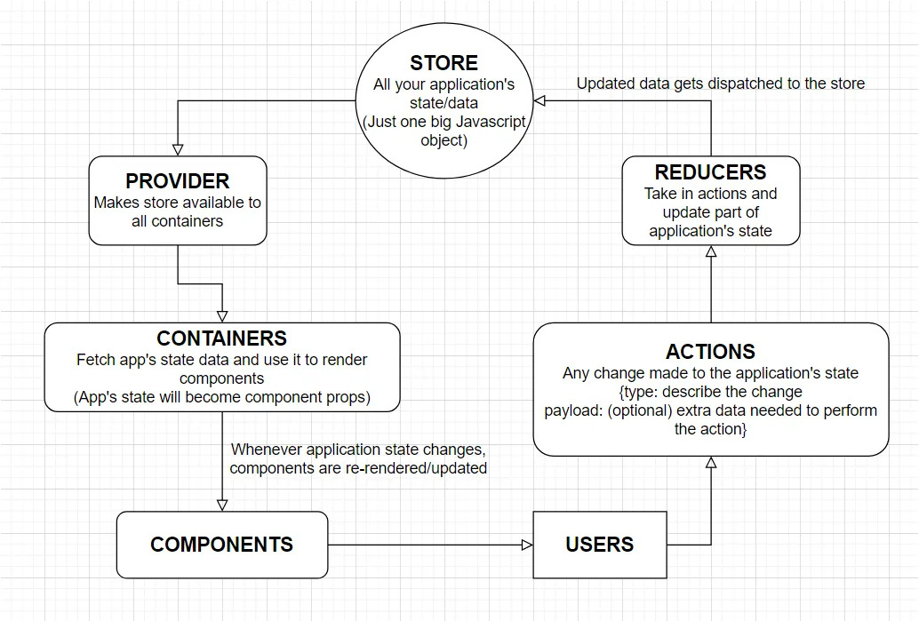
Working of Redux
Store: Centralized state container where all the app's state is stored.
Actions: Plain JavaScript objects that describe what happened (e.g., user clicked a button).
Reducers: Functions that take the current state and an action, then return a new state based on the action.
Dispatch: Sends actions to the store, which triggers the reducer to update the state, and the app re-renders accordingly.

Slide 10
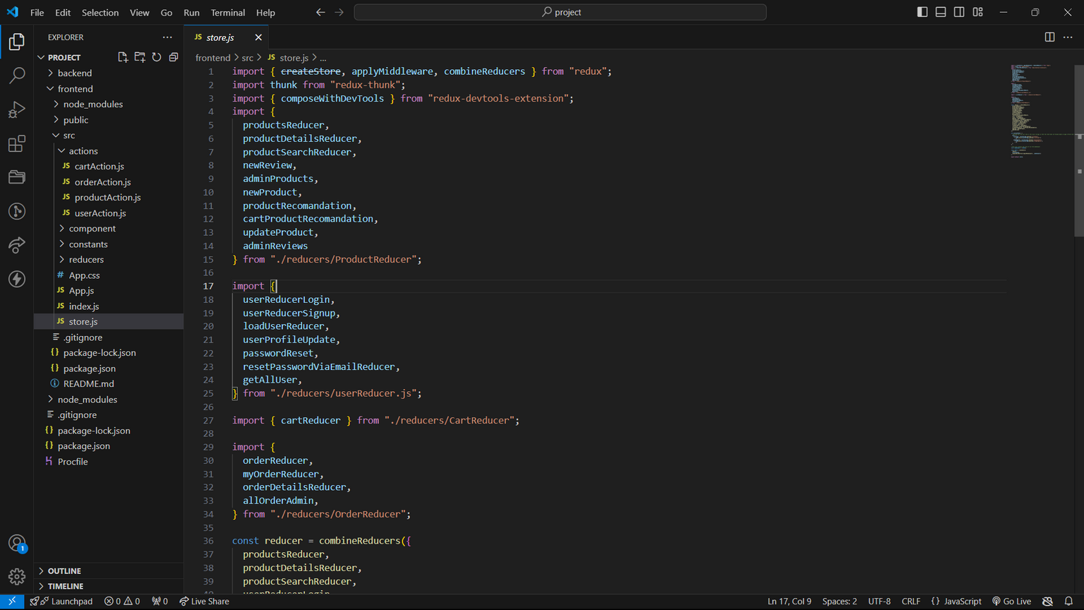
Redux code

Slide 11
How Backend Communicates with Frontend - Request Phase
Frontend Sends a Request
The frontend (client-side) sends a request to the backend (server-side).
Triggered by user actions: form submission, button click, or page load.
Request Types (HTTP Methods)
GET: Retrieve data.
POST: Send new data.
PUT/PATCH: Update existing data.
DELETE: Remove data.
Request Content
Headers: Metadata like authentication tokens or content type.
Body: Data sent to the server (e.g., form data)..

Slide 12
How Backend Communicates with Frontend - Response Phase
Backend Sends a Response
The backend processes the request and sends a response back to the frontend.
Response Types:
Data (JSON, HTML, XML): Processed data like user info, product lists, etc
Status Codes:
200 OK: Success.
404 Not Found: Resource not available.
500 Internal Server Error: Server issue.

Slide 13
Timeline
1
Requirement Gathering
(Week 1-3)
Backend Development
2
(Week 4-6)
3
Frontend Development
(Week 7-11)
Integration of Backend & Frontend (week 8-11)
4
5
Chatbot Implimentation
(Week 11-13)
Final test , Deploy & Launch
6
(Week 13-15)

Slide 14

Conclusion
The integration of the front-end and back-end is essential for seamless user interactions and real-time data exchange. This ensures efficient functionality and enhances user satisfaction in the application.
Reference
Streamlining-backend-frontend-integration
Interaction-between-frontend-and-backend
How Redux works ?
Nextstep
Implementation of Chatbot

Slide 15

{
"message": "Thank you"
}

